Slide 1
Design & Analysis of Algorithm
Introduction to Algorithms by Cormen
Number Theoretic Algorithms
Chapter 31

Slide 2
Divisors
Let a, b and c be integers such that
a = b ·c .
Then b and c are said to divide (or are factors) of a, while a is said to be a multiple of b (as well as of c). The pipe symbol “|” denotes “divides” so the situation is summarized by:
b | a ∧ c | a .

Slide 3
Divisors Examples
Q: Which of the following is true?
77 | 7
7 | 77
24 | 24
0 | 24
24 | 0

Slide 4
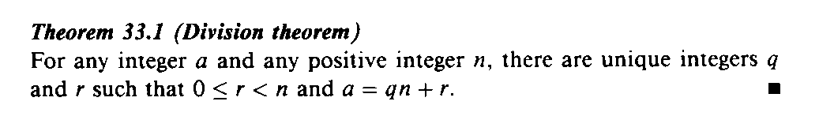
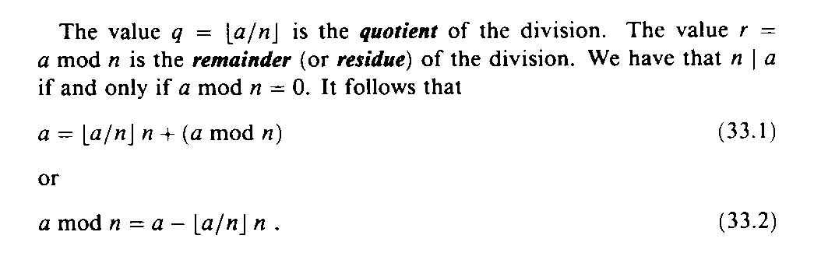
Division & Remainders
31.1

Slide 5
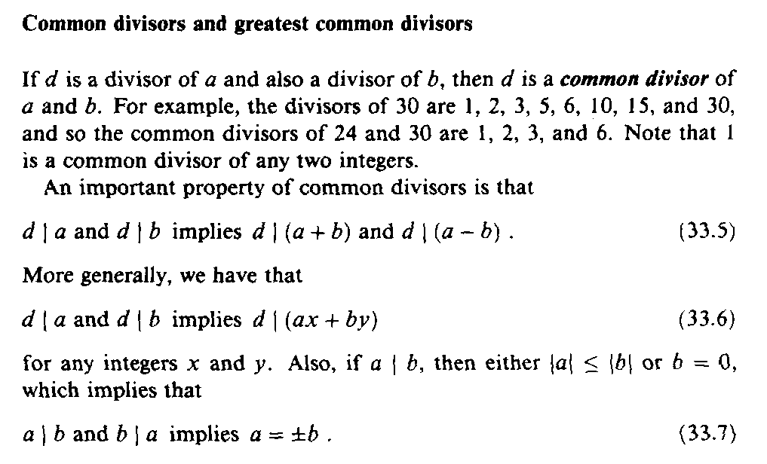
Common Divisors

Slide 6
Greatest Common Divisor Relatively Prime
Let a,b be integers, not both zero. The greatest common divisor of a and b (or gcd(a,b) ) is the biggest number d which divides both a and b.
a and b are said to be relatively prime if gcd(a,b) = 1, so no prime common divisors.

Slide 7
Greatest Common Divisor Relatively Prime
Q: Find the following gcd’s:
gcd(11,77)
gcd(33,77)
gcd(24,36)
gcd(24,25)

Slide 8
Greatest Common Divisor Relatively Prime
A:
gcd(11,77) = 11
gcd(33,77) = 11
gcd(24,36) = 12
gcd(24,25) = 1. Therefore 24 and 25 are relatively prime.
NOTE: A prime number are relatively prime to all other numbers which it doesn’t divide.

Slide 9
Greatest Common Divisor Relatively Prime
EG: More realistic. Find gcd(98,420).
Find prime decomposition of each number and find all the common factors:
98 = 2·49 = 2·7·7
420 = 2·210 = 2·2·105 = 2·2·3·35
= 2·2·3·5·7
Underline common factors: 2·7·7, 2·2·3·5·7
Therefore, gcd(98,420) = 14

Slide 10
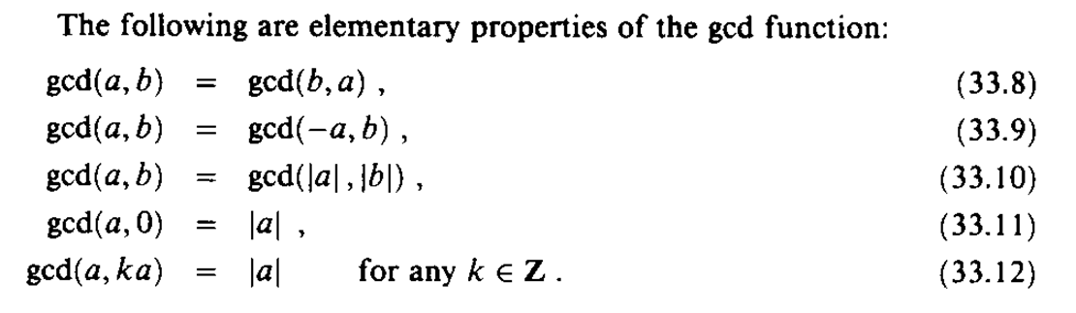
Greatest Common Divisor

Slide 11
The GCD and Linear Combinations
Theorem 31.2: If a and b are integers not both 0, then gcd(a, b) is the smallest positive element of the set {ax + by : x, y are integers} of linear combinations of a and b. Proof: see text p. 853.

Slide 12
The GCD and Linear Combinations (2)
Corollaries:
For any integers a and b, if d|a and d|b then d|gcd(a, b).
For all integers a and b and any nonnegative integer n, gcd(an, bn) = n gcd(a, b).
For all positive integers n, a, and b, if n|ab and gcd(a, n) = 1, then n|b.

Slide 13
Relatively Prime Integers
Two integers a and b are relatively prime if and only if their only common divisor is 1 (i.e., gcd(a, b) = 1).
Theorem 31.6: For any integers a, b, and p, if both gcd(a, p) = 1 and gcd(b, p) = 1, then gcd(ab, p) = 1. Proof: p. 854 in text.

Slide 14
Divisibility by Primes
Theorem 31.7: For all primes p and all integers a, b, if p|ab, then p|a or p|b (or both). Proof: p. 854 in text

Slide 15
The GCD Recursion Theorem
Theorem 31.9 (GCD recursion theorem): For any nonnegative integer a and any positive integer b, gcd(a, b) = gcd(b, a mod b). Proof: p. 857 of the text.

Slide 16
Euclid’s Algorithm – Finding GCD
Based on the following theorem
gcd(a, b) = gcd(b, a mod b)
Proof
If d = gcd(a, b), then d|a and d|b
For any positive integer b, a = kb + r ≡ r mod b, a mod b = r
a mod b = a – kb (for some integer k)
because d|b, d|kb
because d|a, d|(a mod b)
∴ d is a common divisor of b and (a mod b)
Conversely, if d is a common divisor of b and (a mod b), then d|kb and d|[ kb+(a mod b)]
d|[ kb+(a mod b)] = d|a
∴ Set of common divisors of a and b is equal to the set of common divisors of b and (a mod b)
ex) gcd(18,12) = gcd(12,6) = gcd(6,0) = 6
gcd(11,10) = gcd(10,1) = gcd(1,0) = 1

Slide 17
Euclid’s GCD Algorithm
Euclid(a, b):
if (b == 0)
return a
else
return Euclid(b, a mod b)

Slide 18
Euclid’s Algorithm – Finding GCD
Recursive algorithm
Function Euclid (a, b) /* assume a ≥ b ≥ 0 */
if b = 0 then return a
else return Euclid(b, a mod b)
Iterative algorithm
Euclid(d, f) /* assume d > f > 0 */
1. X ← d; Y ← f
2. if Y=0 return X = gcd(d, f)
3. R = X mod Y
4. X ← Y
5. Y ← R
6. goto 2

Slide 19
Euclid’s Algorithm Example
Euclid(1155, 546) =
Euclid(546, 63) =
Euclid(63, 42) =
Euclid(42, 21) =
Euclid(21, 0)
The gcd of 1155 and 546 is 21.

Slide 20
Properties of Euclid’s Algorithm
Since the second argument is monotonically decreasing, and the gcd is positive, the algorithm terminates.
Theorem 31.9 implies that the algorithm computes the gcd correctly.

Slide 21
Extended Euclidean Algorithm
You are given two integer number a and b. Find integer coefficients x and y such that
d=gcd(a, b) = ax+by
The extended Euclidean algorithm works the same as the regular Euclidean algorithm except that we keep track of more details –namely the quotient q = a/b in addition to the remainder r = a mod b. This allows us to backtrack and write the gcd(a,b) as a linear combination of a and b.

Slide 22
Extended Euclid’s Algorithm
ExtEuclid(a, b):
if b == 0
return (a, 1, 0)
(d´, x´, y´) ← ExtEuclid(b, a mod b)
(d, x, y) ← (d´, y´, x´-floor(a/b)·y´) return (d, x, y)
d = gcd(a, b) = ax + by

Slide 23
Extended Euclid’s Algorithm
Suppose a and b are given. Find x and y such that,
ax+by=gcd (a,b)
Let, d=gcd(a,b)
Then, ax+by=d [by Thm 31.2]
Again, gcd(a,b)=gcd(b, a mod b)
So, ax+by = d = bx´+(a mod b)y´
We know that, a = b.⎣a/b⎦+a mod b
So, a mod b = a – b.⎣a/b⎦
Thus, ax+by = bx´+(a – b.⎣a/b⎦).y´
= ay´+b(x´- ⎣a/b⎦.y´)
Finally, x = y´
y =x´- ⎣a/b⎦.y´
x , y
x´, y´

Slide 24
Finding Prime Factors
How can we calculate the primes between [1, N] ?
Can we determine if a given number K is prime or not
using [2-K-1] loop
using (K/2) loop
using sqrt(K) loop
K = c*d, [c=d=sqrt(K)], [c>sqrt(K), d<sqrt(K)]

Slide 25
Sieve of Eratosthenes
An efficient technique to find the primes within [1,N]
idea is to clip out multiples of primes

Slide 26
Using Sieve to detect primes
Will calculate the primes between [1,30]
Define an array status[31]
if status[i] == 0, i is prime
if status[i] == 1, i is not prime
initially assume every i is prime

Slide 27
Using Sieve to detect primes
1 | 2 | 3 | 4 | 5
6 | 7 | 8 | 9 | 10
11 | 12 | 13 | 14 | 15
16 | 17 | 18 | 19 | 20
21 | 22 | 23 | 24 | 25
26 | 27 | 28 | 29 | 30

Slide 28
Using Sieve to detect primes
1 is not prime, status[1] = 1
2 is prime
multiples of 2 is not prime, set status for every 2*i as not prime

Slide 29
Using Sieve to detect primes
1 | 2 | 3 | 4 | 5
6 | 7 | 8 | 9 | 10
11 | 12 | 13 | 14 | 15
16 | 17 | 18 | 19 | 20
21 | 22 | 23 | 24 | 25
26 | 27 | 28 | 29 | 30
For (i=4, i<=N;i=i+2) status[i] = 1

Slide 30
Using Sieve to detect primes
Now iterate over the odd numbers
If it is prime, untrack its multiples from being prime
For a number N, it is enough to look within sqrt(N), because it will at least have one prime number within that range which is its factor.
For (i = 3; i<=sqrt(N); i = i+2) {
if (status[i] == 0) {
For(j = 2 * i ; j <=N; j = j + i) {
status[j] = 1
}
}
}

Slide 31
Using Sieve to detect primes
1 | 2 | 3 | 4 | 5
6 | 7 | 8 | 9 | 10
11 | 12 | 13 | 14 | 15
16 | 17 | 18 | 19 | 20
21 | 22 | 23 | 24 | 25
26 | 27 | 28 | 29 | 30
For i = 3

Slide 32
Using Sieve to detect primes
1 | 2 | 3 | 4 | 5
6 | 7 | 8 | 9 | 10
11 | 12 | 13 | 14 | 15
16 | 17 | 18 | 19 | 20
21 | 22 | 23 | 24 | 25
26 | 27 | 28 | 29 | 30
For i = 5

Slide 33
Using Sieve to detect primes
For (i = 3; i<=sqrt(N); i = i+2) {
if (status[i] == 0) {
For(j = i * i ; j <=N; j = j + 2 * i) {
status[j] = 1
}
}
}
(i+1) is even which is already been detected from 2
Optimization: because smaller multiples already been sieved/cut

Slide 34
Utilities
After tracking the primes, it is very easy to factorize each number
let such array/vector be primes
For (i=0; i<prime.size() && primes[i] <= sqrt(N); i++) {
while (N%primes[i] == 0) {
N = N/primes[i] // detecting powers + primes
}
}
if N is not 1, this remaining factor of N is a prime.

Slide 35
Prime Factorization
Each number N can be represented as the multiplication of some prime factors with their corresponding power, e.g.,
20 = 2² * 5
1260 = 2² * 3² * 5 * 7
General term,
N = p₁ª x p₂^{b} x p₃^{c} …. x p_{n}^{m} where each P_{i} is a prime number and k (in P_{i}^{k}) is the largest power of P_{i} that divides N (N%P_{i}^{k} == 0).

Slide 36
GCD from Prime Factorization
Idea: As GCD means the greatest common divisor, the common primes with their common powers will eventually determine the GCD of two numbers. E.g.,
Let a number be N₁ = 3² * 5⁴ * 7³
Let a number be N₂ = 2² * 3³ * 7⁴
GCD (N1, N2) = 3² * 7³, the common primes were 3 and 7 with their common powers are 2 and 3 respectively.

Slide 37
GCD from Prime Factorization
Theory:
N1 = p_{i}ª x p_{i+1}^{b} x p_{i+2}^{c} …. x p_{i+k}^{f}
N2 = p_{j}^{m} x p_{j+1}^{n} x p_{j+2}º …. x p_{j+l}^{t}
GCD(N1, N2) = multiplication of all P_{x}^{y} where P_{x} belongs to the prime factorization of both and y is the greatest common power that divides both N1 and N2.

Slide 38
LCM from Prime Factorization
Idea: As LCM means the lowest common multiple, we can incorporate each prime that is found between the numbers with their largest found power. E.g.,
Let a number be N₁ = 3² * 5⁴ * 7³
Let a number be N₂ = 2² * 3³ * 7⁴
LCM(N1, N2) = 2² * 3³ * 5⁴ * 7⁴, corporated each prime with their maximum found power. This is the least multiple that is divided by both N1 and N2.

Slide 39
LCM from Prime Factorization
Theory:
N1 = p_{i}ª x p_{i+1}^{b} x p_{i+2}^{c} …. x p_{i+k}^{f}
N2 = p_{j}^{m} x p_{j+1}^{n} x p_{j+2}º …. x p_{j+l}^{t}
LCM(N1, N2) = multiplication of all P_{x}^{y} where P_{x} belongs to either in the prime factorization of N1 or N2 or both and y is the largest power found in the occurrence.

